Slide 1
A First Book of ANSI C Fourth Edition
Chapter 10
Data Files

Slide 2
Objectives
Declaring, Opening, and Closing File Streams
Reading from and Writing to Text Files
Random File Access
Passing and Returning Filenames

Slide 3
Objectives (continued)
Case Study: Creating and Using a Table of Constants
Writing and Reading Binary Files (Optional)
Common Programming and Compiler Errors

Slide 4
Declaring, Opening, and Closing File Streams
To store and retrieve data outside a C program, you need two items:
A file
A file stream

Slide 5
Files
File: collection of data that is stored together under a common name, usually on a disk, magnetic tape, or CD-ROM
Each file has a unique filename, referred to as the file’s external name
For example, prices.dat and info.txt

Slide 6
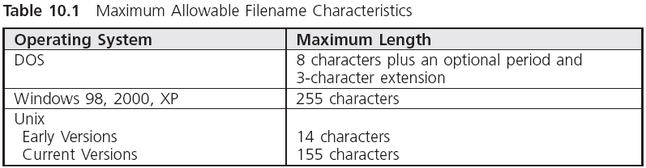
Files (continued)

Slide 7
Files (continued)
Most C compilers require a program file to have either the extension c or cpp
There are two basic types of files
Text files (also known as character-based files): store each individual character, such as a letter, digit, dollar sign, decimal point, and so on, using an individual character code
Binary files: use the same code as your computer processor uses internally for C’s primitive data types
Advantage: speed and compactness

Slide 8
File Streams
File stream: one-way transmission path used to connect a file stored on a physical device to a program
Input file stream: receives data from a file into a program
Output file stream: sends data to a file

Slide 9
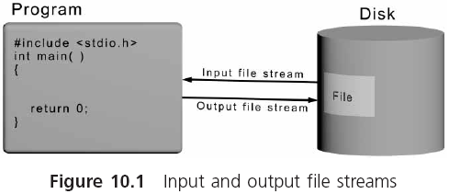
File Streams (continued)

Slide 10
Declaring a File Stream
For each file that your program uses, a file stream must be named (declared) and created (opened)
Naming a file stream is accomplished by declaring a variable name to be of type FILE
FILE *inFile;
Asterisk is necessary
Name is selected by programmer and internal to the program
The FILE data structure is declared in stdio.h

Slide 11
Opening a File Stream
Opening a file stream (or opening the file):
Establishes the physical communication link between the program and the data file
Equates a specific external filename to the name declared in the FILE declaration statement
Use fopen() (declared in stdio.h)
outFile = fopen("prices.bnd","w");
fileOut = fopen("prices.dat", "wb");
inFile = fopen("prices.bnd","r");
If a file opened for reading does not exist, fopen() returns the NULL address value

Slide 12
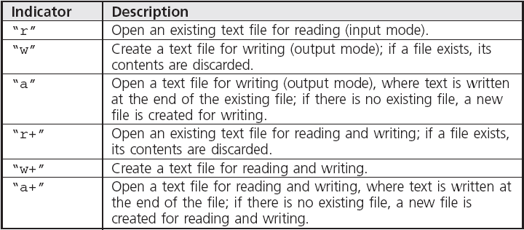
Opening a File Stream (continued)

Slide 13
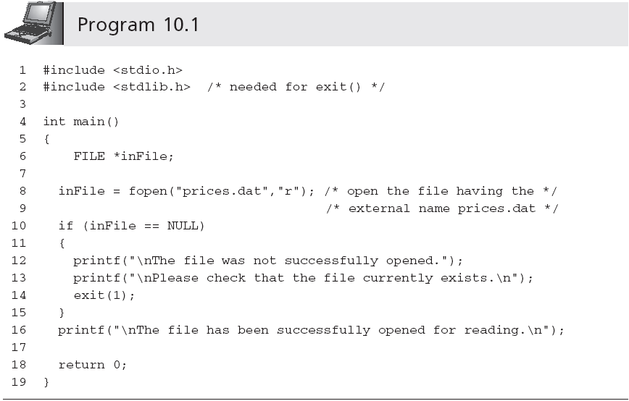
Opening a File Stream (continued)
if ((inFile = fopen("prices.dat","r")) == NULL )
passes its integer argument directly to the operating system and then terminates program operation; declared in stdlib.h

Slide 14
Opening a File Stream (continued)
Approach in Program 10.1 does not work for output files
If a file exists having the same name as the file to be opened for writing, the existing file is erased and all its data is lost
The file can first be opened in input mode, simply to see if it exists
If it does, the user is given the choice of explicitly permitting it to be overwritten when it is subsequently opened in output mode

Slide 15
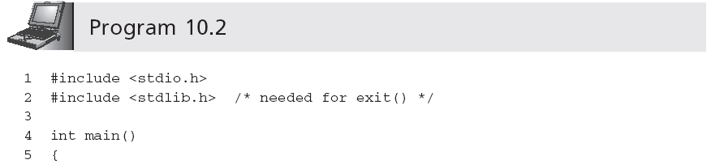
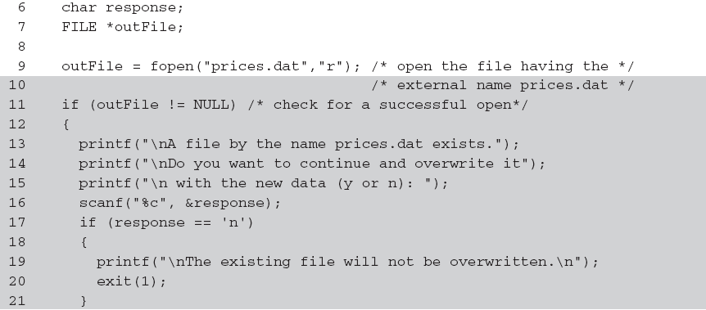
Opening a File Stream (continued)

Slide 16
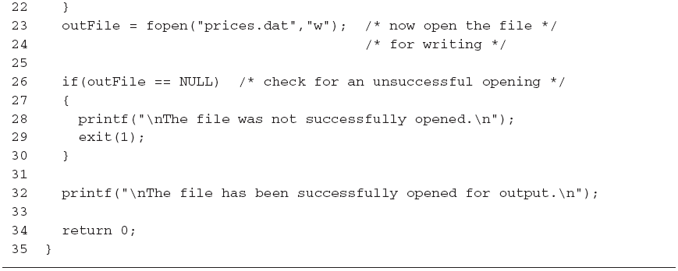
Opening a File Stream (continued)
Sample run 1:
A file by the name prices.dat exists.
Do you want to continue and overwrite it
with the new data (y or n): n
The existing file will not be overwritten.
Sample run 2:
A file by the name prices.dat exists.
Do you want to continue and overwrite it
with the new data (y or n): y
The file has been successfully opened for output.

Slide 17
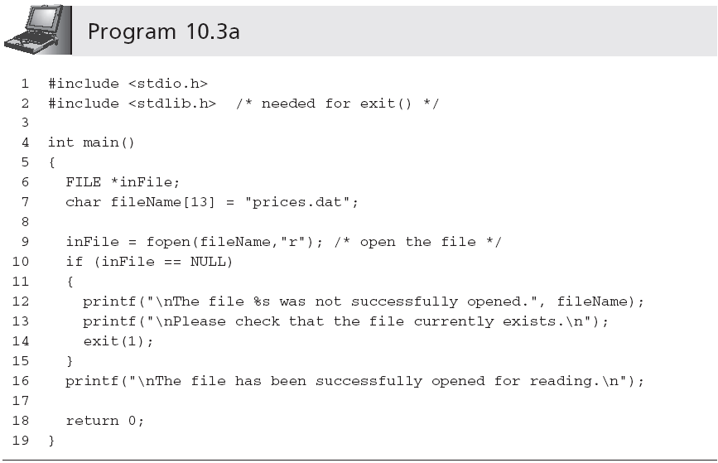
Embedded and Interactive Filenames

Slide 18
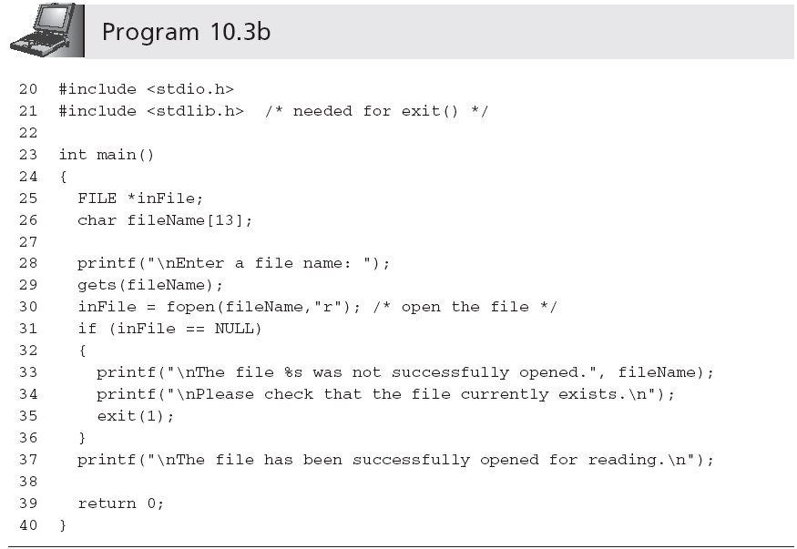
Embedded and Interactive Filenames (continued)

Slide 19
Closing a File Stream
A file stream is closed using fclose()
fclose() breaks the link between the file’s external and internal names, releasing the internal file pointer name, which can then be used for another file
fclose(inFile);
Because all computers have a limit on the maximum number of files that can be open at one time, closing files that are no longer needed makes good sense
Open files existing at the end of normal program execution are closed by the operating system

Slide 20
Reading from and Writing to Text Files
Prototypes in stdio.h
Examples
fputc('a',outFile);
fputs("Hello world!",outFile);
fprintf(outFile,"%s %n",descrip,price);

Slide 21
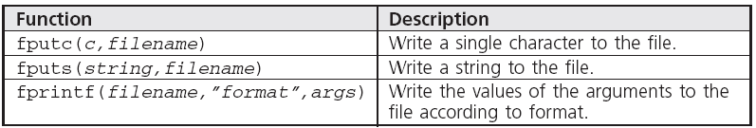
Reading from and Writing to Text Files (continued)

Slide 22
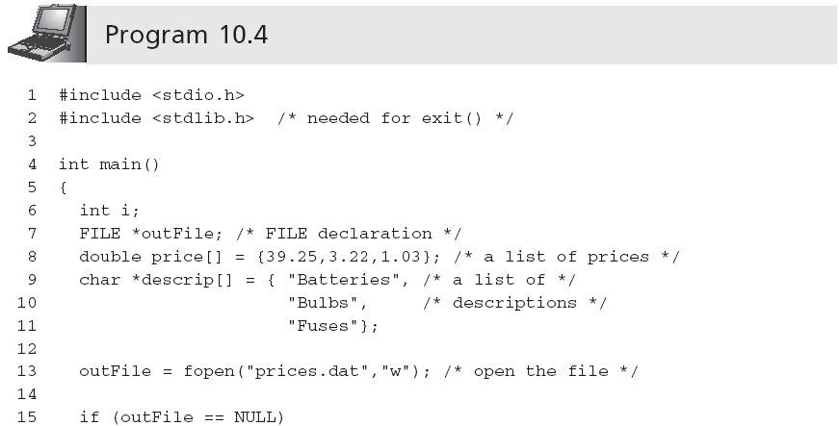
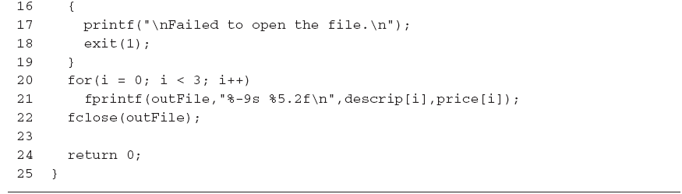
Reading from and Writing to Text Files (continued)
prices.dat:
Batteries 39.25
Bulbs 3.22
Fuses 1.03

Slide 23
Reading from and Writing to Text Files (continued)
C appends the low-value hexadecimal byte 0x00 as the end-of-file (EOF) sentinel when the file is closed
EOF sentinel is never counted as part of the file

Slide 24
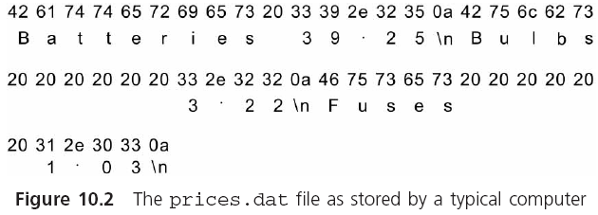
Reading from and Writing to Text Files (continued)

Slide 25
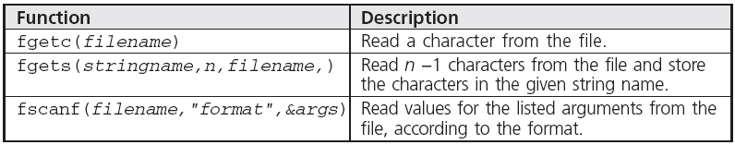
Reading from a Text File
Prototypes in stdio.h
Examples
fgetc(inFile);
fgets(message,10,inFile);
fscanf(inFile,"%lf",&price);
fgetc() and fscanf() return EOF when the end-of-file marker is detected
fgets() returns a NULL instead

Slide 26
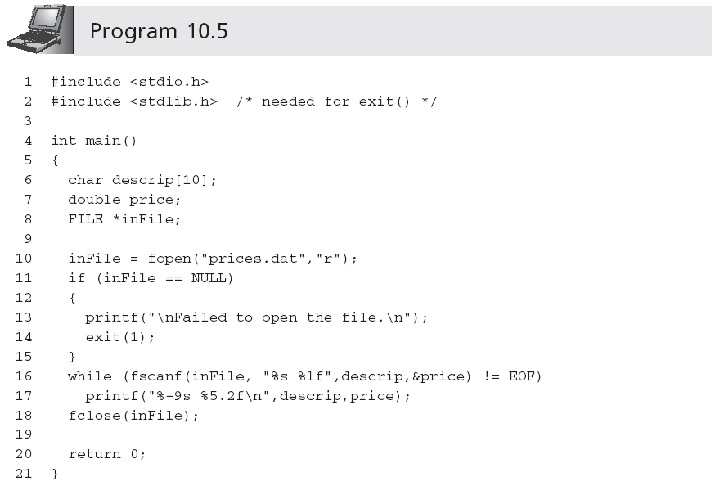
Reading from a Text File (continued)

Slide 27
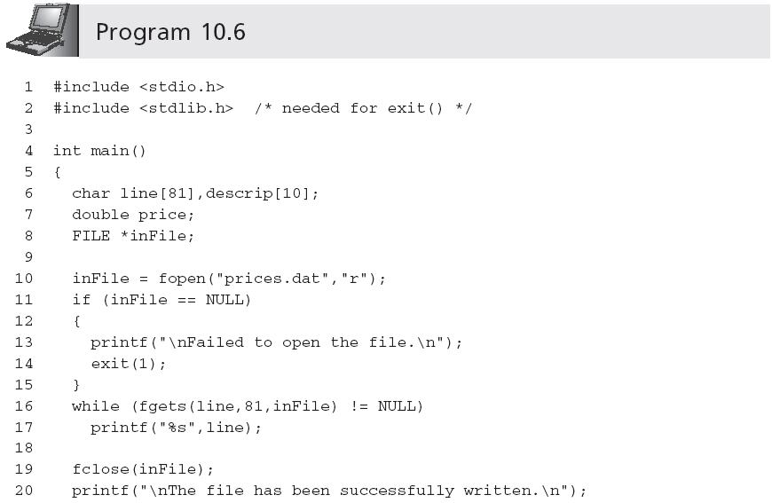
Reading from a Text File (continued)

Slide 28
Standard Device Files
When a program is run, the keyboard used for entering data is automatically opened and assigned to the internal file pointer name stdin
fscanf(stdin,"%d",&num);
The output device used for display is assigned to the file pointer named stdout
fprintf(stdout,"Hello World!");
stderr is assigned to the output device used for system error messages
stderr and stdout often refer to the same device

Slide 29
Standard Device Files (continued)
The character function pairs listed in Table 10.2 can be used as direct replacements for each other
This is not true for the string-handling functions

Slide 30
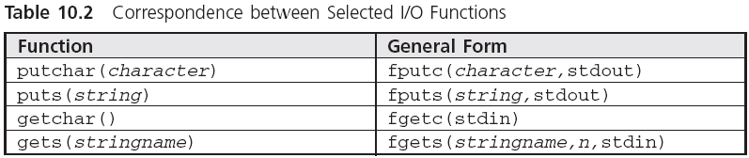
Standard Device Files (continued)

Slide 31
Other Devices
Most IBM or IBM-compatible personal computers assign the name prn to the printer connected to the computer
fprintf("prn","Hello World!");
prn is not a pointer constant but the actual name of the device; as such, it must be enclosed in double quotes when used in a statement

Slide 32
Random File Access
rewind() resets the current position to the start of the file
rewind(inFile)
fseek() allows the programmer to move to any position in the file
fseek(fileName, offset, origin)
Origin: SEEK_SET, SEEK_CUR, and SEEK_END
ftell() returns the offset value of the next character that will be read or written
ftell(inFile);

Slide 33
Random File Access (continued)
Examples of fseek() are
fseek(inFile,4L,SEEK_SET);
fseek(inFile,4L,SEEK_CUR);
fseek(inFile,-4L,SEEK_CUR);
fseek(inFile,0L,SEEK_SET);
fseek(inFile,0L,SEEK_END);
fseek(inFile,-10L,SEEK_END);

Slide 34
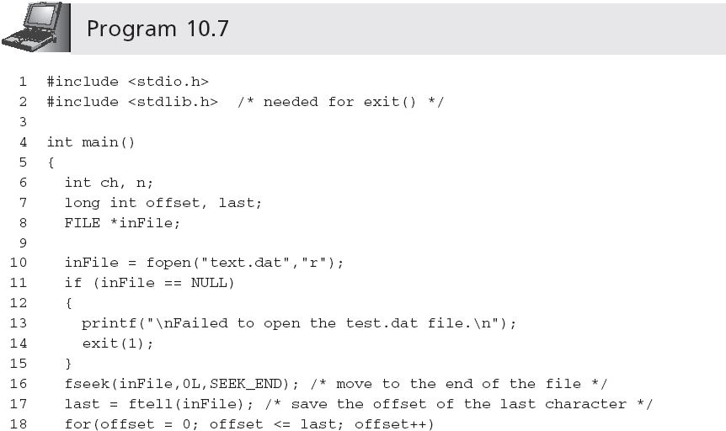
Random File Access (continued)

Slide 35
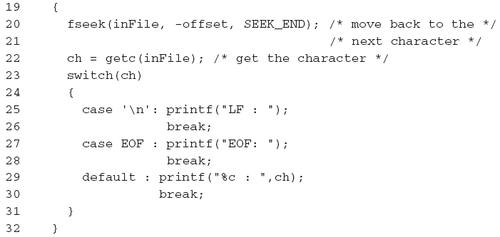
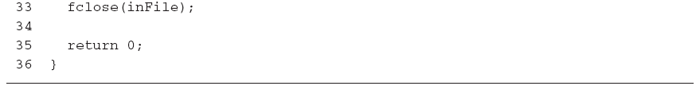
Random File Access (continued)

Slide 36
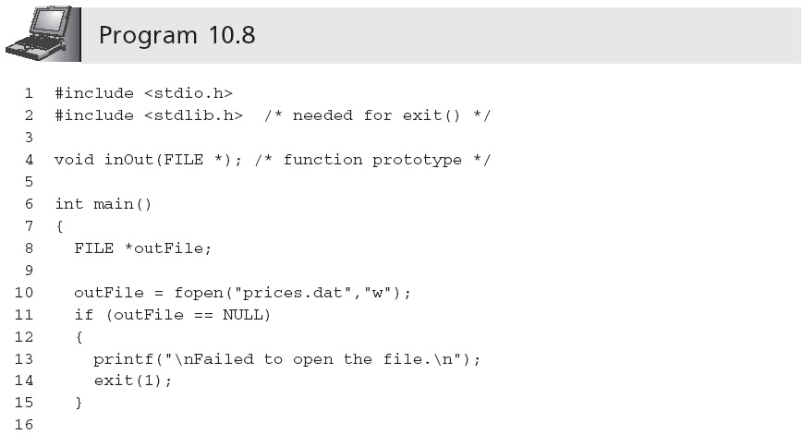
Passing and Returning Filenames

Slide 37
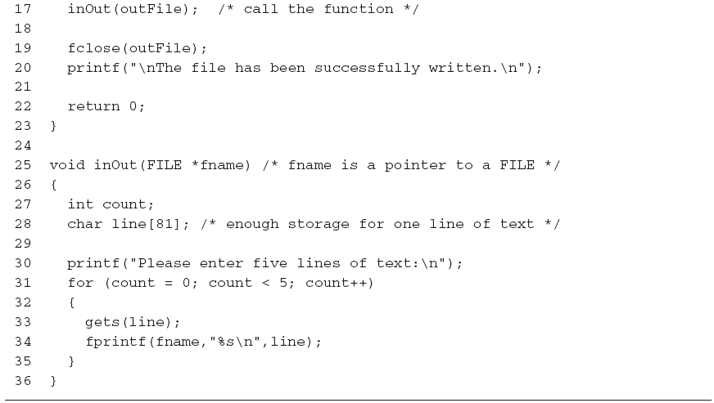
Passing and Returning Filenames (continued)

Slide 38
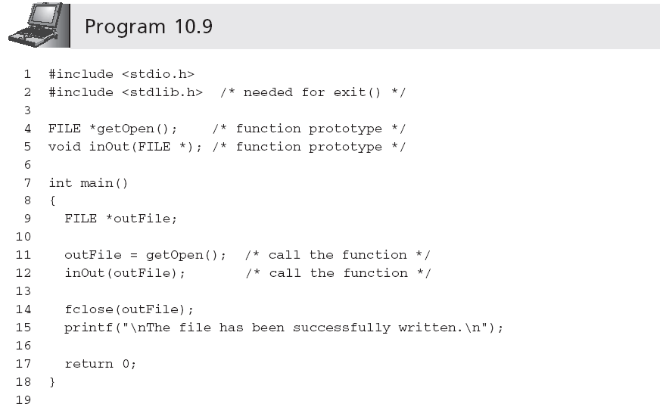
Passing and Returning Filenames (continued)

Slide 39
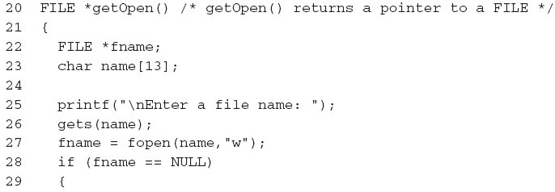
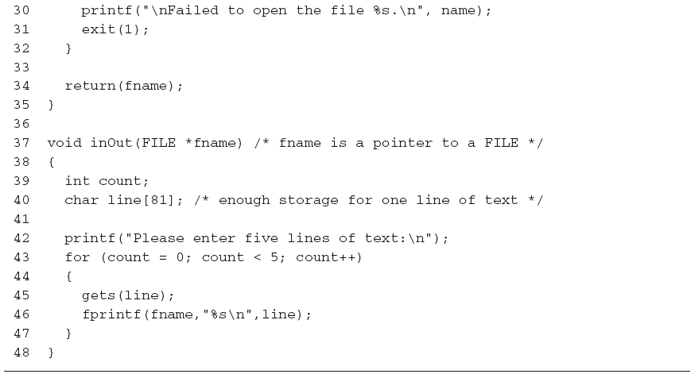
Passing and Returning Filenames (continued)

Slide 40
Case Study: Creating and Using a Table of Constants
A common real-world programming requirement is creating and maintaining a small file of constants, reading and storing these constants into a list, and then providing functions for checking data against the constants in the list
In financial and scheduling programs, this requirement takes the form of reading a set of holiday dates and then checking a date against each date in the table

Slide 41
Requirements Specification
Objective: create a set of functions that determines if a given date is a holiday, using concepts that are equally applicable to any program that needs to check data against a list of constants, such as temperatures, densities, or other parameters
Two functions are developed
The first constructs a list of holidays, which is called a holiday table, and consists of legal holiday dates that have been previously stored in a file
The second compares any given date to the dates in the table and determines if there is a match

Slide 42
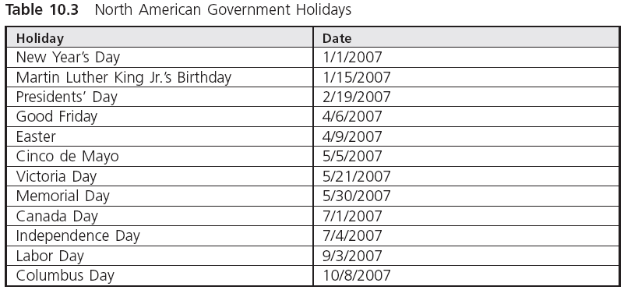

Analysis for the First Function

Slide 43
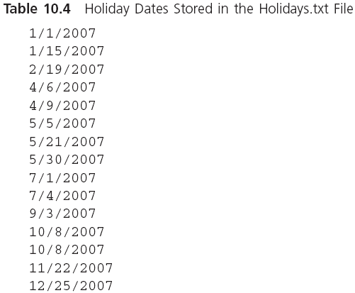
Analysis for the First Function (continued)

Slide 44
Code the Function
Create an array capable of storing 20 integers
Set a counter to 0
Open the Holidays.txt file, checking that a successful open occurred
While there are dates in the file
Read a date as a month, day, and year
Convert date to an integer having the form yyyymmdd
Assign the integer date to the Holiday array
Add 1 to the counter
EndWhile
Close the Holidays.txt file
Return the value of the counter

Slide 45
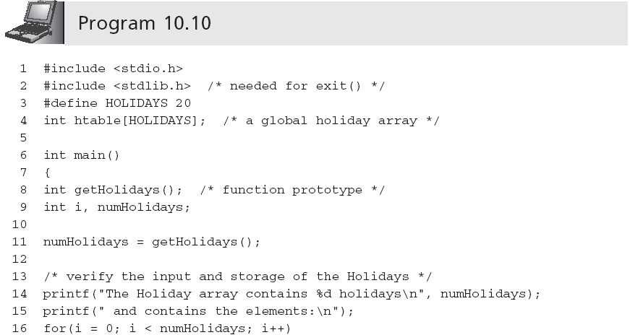
Test and Debug the Function

Slide 46
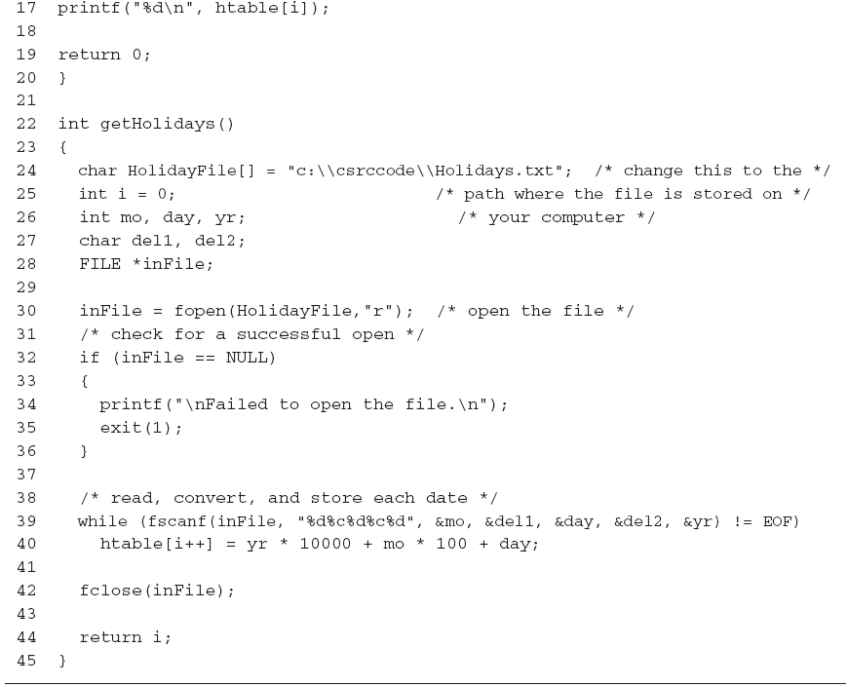
Test and Debug the Function (continued)

Slide 47
Analysis for the Second Function
If the holiday table is empty
Call getHolidays()
EndIf
For all Holidays in the table
Retrieve the holiday from the table
Compare the date being tested to the date retrieved from the array
If there is a match
Return 1
EndFor
Return 0

Slide 48
Code the Function
1 int isHoliday(int testDate)
2 {
3 int getHolidays(); /* function prototype */
4 #define TRUE 1
5 #define FALSE 0
6 int i;
7
8 /* read the Holiday file if the Holiday array is empty */
9 if (htable[0] == 0)
10 getHolidays();
11
12 /* search the Holiday array for the given date */
13 for(i = 0; i < HOLIDAYS; i++)
14 if (testDate == htable[i])
15 return TRUE;
16
17 return FALSE;
18 }

Slide 49
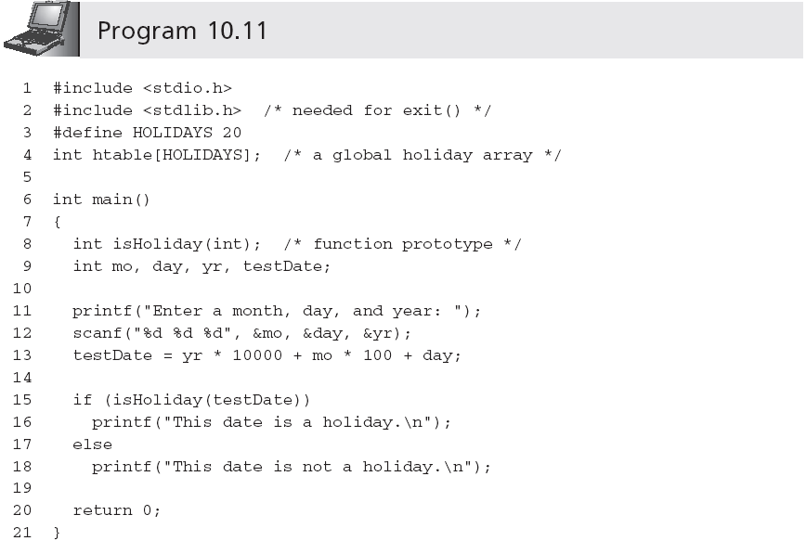
Test and Debug the Function

Slide 50
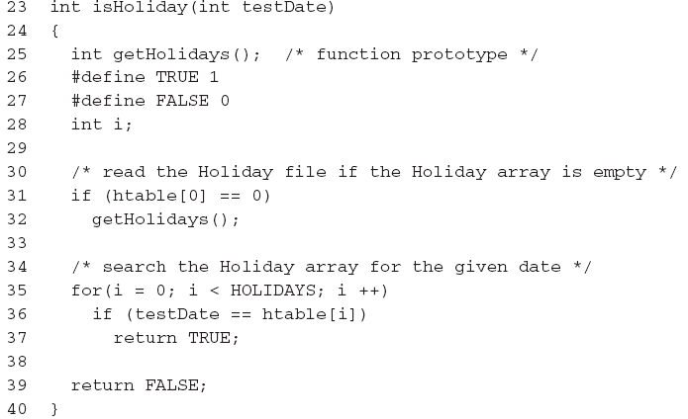
Test and Debug the Function (continued)

Slide 51
Writing and Reading Binary Files
Binary files store numerical values using the computer’s internal numerical code
No number-to-character conversion when writing a number to a file, and no character-to-number conversion when a value is read from the file
Resulting file frequently requires less storage space than its character-based counterpart

Slide 52
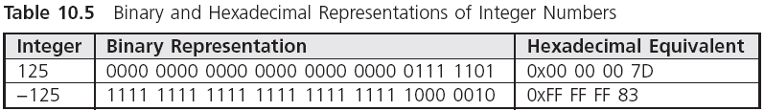
Writing and Reading Binary Files (continued)

Slide 53
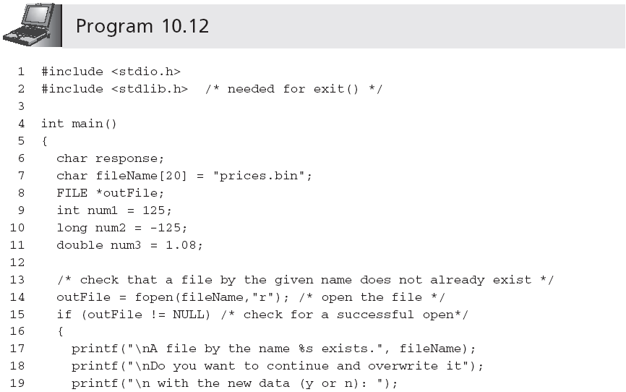
Writing and Reading Binary Files (continued)

Slide 54
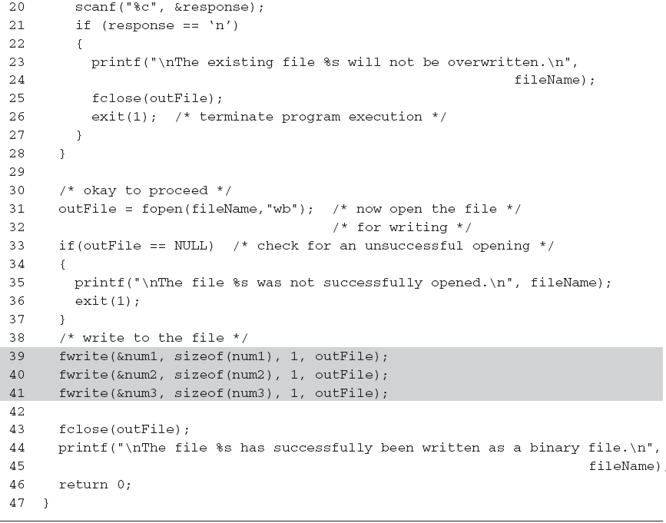
Writing and Reading Binary Files (continued)

Slide 55

Writing and Reading Binary Files (continued)

Slide 56
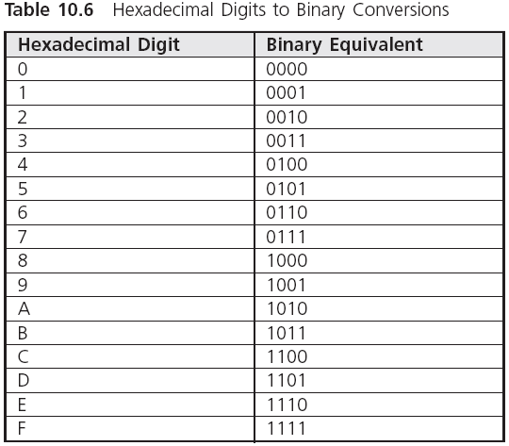
Writing and Reading Binary Files (continued)

Slide 57
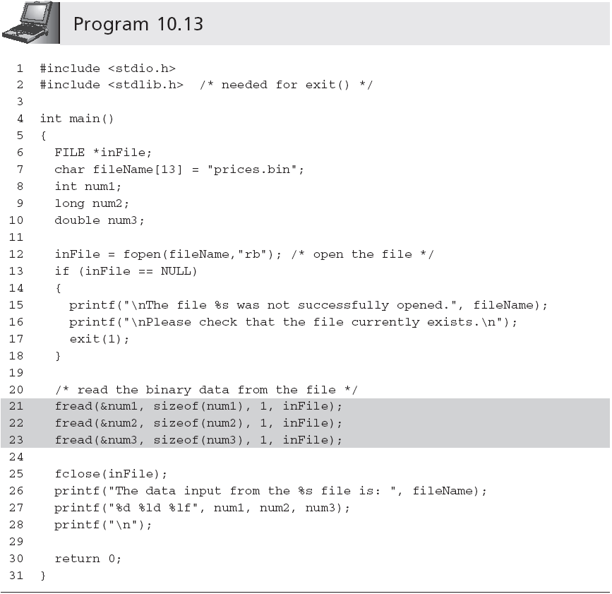
Writing and Reading Binary Files (continued)

Slide 58
Common Programming Errors
Using a file’s external name in place of the internal file pointer variable name when accessing the file
Omitting the file pointer name altogether
Opening a file for output without first checking that a file with the given name already exists
Not understanding the end of a file is only detected until after the EOF sentinel has either been read or passed over

Slide 59
Common Programming Errors (continued)
Attempting to detect the end of a file using character variable for the EOF marker
Supplying an integer argument offset to the seekg() and seekp() functions
Not using the sizeof() operator when specifying the number of bytes to be written when writing a binary file
Not using the sizeof() operator when specifying the number of bytes to be read when reading a binary file

Slide 60
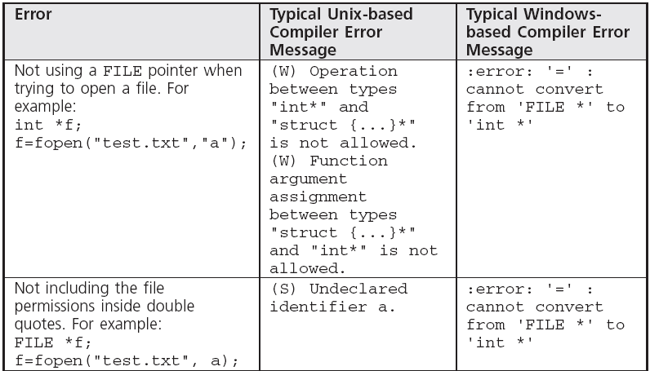
Common Compiler Errors

Slide 61
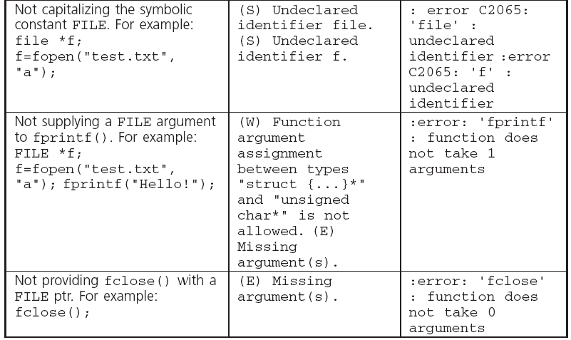
Common Compiler Errors (continued)

Slide 62
Summary
A data file is any collection of data stored together in an external storage medium under a common name
Data files can be stored as either character-based or binary files
A data file is opened using the fopen() standard library function
A file can be opened for reading, writing, or appending

Slide 63
Summary (continued)
An internal filename must be declared as a pointer to a FILE
In addition to any files opened within a function, the standard files stdin, stdout, and stderr are automatically opened when a program is run
Data files can be accessed randomly using rewind(), fseek(), and ftell()
Table 10.7 lists the standard file library functions

